Slide 1

STUDENTS AGAINST SUPERBUGS-AFRICA

Slide 2
Background
What is an antimicrobial?
These are drugs used to treat infections caused by bacteria, fungi, viruses and parasites
Discovery of penicillin.
Who? Alexander Fleming
When? 1928
AMR is the ability of microbes to grow in the presence of a drug that would normally kill or limit their growth.

Slide 3
Examples of AMR
Candida spp is becoming increasingly resistant to the antifungal medications like fluconazole.
Resistance to NNRTIs by HIV ranged between 2.7% (in Myanmar) to 15.9% (in Uganda) in 2017.
Malaria – Chloroquine no longer first line drug in the management of malaria IN 2009 due to reported resistance
MRSA – A form of bacteria that does not respond to penicillins.

Slide 4
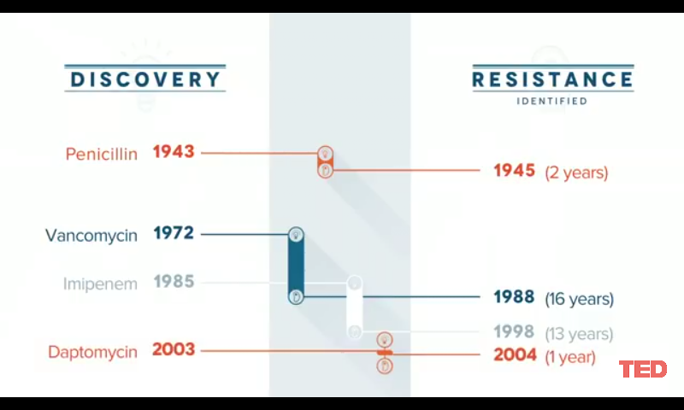
History of antibiotic resistance

Slide 5
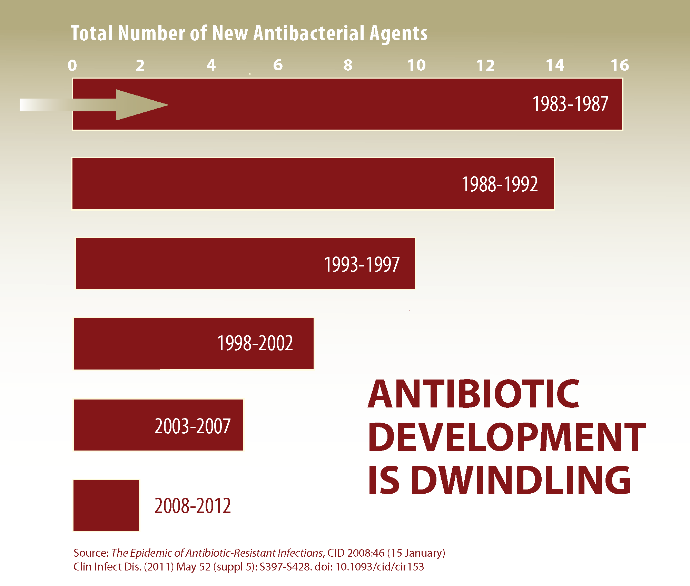
The dry antibiotic pipeline

Slide 6
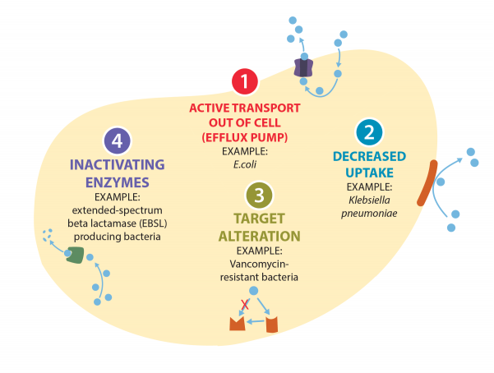
Mechanisms of AMR

Slide 7
Drivers of AMR
Inappropriate use of antimicrobials
Inappropriate use of antimicrobials in animals
Poor infection control practices
Inadequate regulation and enforcement
Pharmaceutical drug promotion
Poor quality of antimicrobials
Inadequate monitoring and surveillance for AMR

Slide 8
The burden of AMR
About 700,000 deaths globally are linked to infections due to antimicrobial resistant micro-organisms every year
This figure may surge to 10 million by 2050 if AMR is not put in check.
This will cause low and middle-income countries (LMICs) to lose more than 5% of their GDP
And push up to 28 million people into poverty.

Slide 9
What you can do
A global public awareness campaign It is crucial to educate our societies about the danger behind the overuse and misuse of antimicrobials, as patients still commonly demand them from doctors or buy them over-the-counter. An efficient and well-delivered public campaign in a long-term perspective could reduce the number of prescribed antimicrobials by 36%.
Promote new and rapid diagnostics Every year, 27 million patients in the USA are given antibiotics unnecessarily due to misdiagnosis, which is over 67% of all prescribed antimicrobial therapies. The data is striking, and only development of rapid and accurate diagnostic tests would allow doctors to target antimicrobials to those patients who actually need them

Slide 10
Improve sanitation and prevent the spread of infection Prevention is better than cure – by improving healthcare systems and living standards we can markedly reduce the demand for antibiotics and therefore give less chance for new resistance strains to develop. It is estimated that improving sanitation in low-income countries would decrease the use of antibiotics to treat diarrhea by 60%.

Slide 11
Reduce unnecessary use of antimicrobials in agriculture and their dissemination into the environment The vast majority of global antimicrobial consumption comes from agriculture and aquaculture.
In the USA, over 70% (by total volume per year) of medically important antibiotics are used in agriculture.
The use of antibiotics solely for infection prevention and more importantly, growth promotion, should be considered dangerous and unnecessary.
Moreover, recent data suggest that 75-90% of antibiotics are excreted from animals unmetabolized and leak into the environment.

Slide 12
Improve global surveillance of drug resistance and microbial consumption For scientists and physicians to elucidate the mechanisms of acquiring new resistance, monitor the cases already present and to anticipate future threats, they need to have better insight into current and past AMR-related data. Therefore, three areas require better structure and information: antibiotic consumption among humans and animals, resistance rates for the available drugs and research knowledge on the molecular foundations of AMR.

Slide 13
Promote new and rapid diagnostics Every year, about two-thirds of antibiotic prescriptions are unnecessary.
The data is striking, and only development of rapid and accurate diagnostic tests would allow doctors to target antimicrobials to those patients who actually need them.

Slide 14
Thank You.
SAS-A
+254 716741529/+254 701 114090
Info.sasafrica@gmail.com

