Slide 1
STUDENTS AGAINST SUPERBUGS-AFRICA

Slide 2
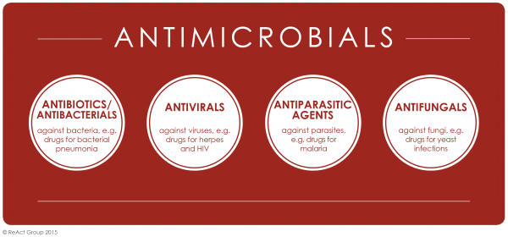
Background
Antimicrobial?
Drugs used to treat infections caused by bacteria, fungi, viruses and parasites

Slide 3
Background
Antibiotics are one type of antimicrobial, referring to medicines used to treat infections caused by bacteria.
Mostly importantly, antibiotics will have no impact on treating infections caused by viruses.

Slide 4
What is antimicrobial resistance (AMR)?
AMR is the ability of microbes to grow in the presence of a drug that would normally kill or limit their growth.
This means previously effective antimicrobial drugs (e.g. antibiotics) used to treat or prevent infections may no longer work.

Slide 5
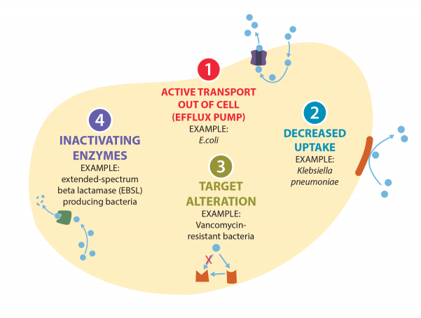
Mechanisms of AMR

Slide 6
Examples Of AMR
Antibiotic Approved or Released | Year Released | Resistant Germ Identified | Year Identified
Penicillin (Antibiotic) | 1943 | Penicillin-resistant Streptococcus pneumonia | 1967
Imipenem (Antibiotic) | 1985 | Carbapenemase producing Klebsiella pneumonia | 1996
Amphotericin B (Antifungal) | 1959 | Amphotericin B-resistant Candida auris | 2016
Fluconazole (Antifungal) | 1990 (FDA approved) | Fluconazole-resistant Candida | 1988

Slide 7
Examples Of AMR
In 2010, an estimated 7% of people starting antiretroviral therapy (ART) in developing countries had drug-resistant HIV.
As of July 2016, resistance to the first-line treatment for P. falciparum malaria (artemisinin-based combination therapies, also known as ACTs)

Slide 8
Dry antibiotic pipeline

Slide 9
Why is AMR a concern?
Treatment failures
Treatment failure to the last resort of medicine for gonorrhoea (third generation cephalosporin antibiotics) has been confirmed in at least 10 countries
Carbapenem antibiotics do not work in more than half of people treated for Klebsiella pneumoniae infections

Slide 10
Why is AMR a concern?
Threatens our ability to perform modern medical procedures
Modern medicine, especially surgery and cancer treatments, depends on effective antibiotics to minimise the risk of infection
Currently, antibiotics reduce post-operative infection rates to below 2.0%
Without effective antibiotics, this could increase to around 40% to 50%. Up to 30% of these patients could die from resistant bacterial infections
The risk of mortality without access to effective antibiotics may make some treatments and surgical procedures too risky to perform.

Slide 11
Why is AMR a concern?
Imposes a major economic burden on society
The cost of health care for patients with resistant infections is higher than care for patients with non-resistant infections due to longer duration of illness, additional tests and use of more expensive drugs
This will cause low and middle-income countries (LMICs) to lose more than 5% of their GDP and push up to 28 million people into poverty.
If AMR is not put in check it will account for $100 trillion in healthcare costs

Slide 12
Why is AMR a concern?
Antibiotic resistant bacteria already cause many deaths around the world
About 700,000 deaths globally are linked to infections due to antimicrobial-resistant micro-organisms and this figure may surge to 10 million by 2050 if AMR is not put in check.
Antimicrobial resistance is putting the gains of the MDGs at risk and endangers achievement of the SDGs

Slide 13
Deaths attributed to AMR

Slide 14
Drivers of AMR
Inappropriate use of antimicrobials
Inappropriate use of antimicrobials in animals
Poor infection control practices
Inadequate regulation and enforcement
Pharmaceutical drug promotion
Poor quality of antimicrobials
Inadequate monitoring and surveillance for AMR

Slide 15
The burden of AMR
About 700,000 deaths globally are linked to infections due to antimicrobial resistant micro-organisms every year.
This figure may surge to 10 million by 2050 if AMR is not put in check.
This will cause low and middle-income countries (LMICs) to lose more than 5% of their GDP.
And push up to 28 million people into poverty.

Slide 16
What you can do
A global public awareness campaign It is crucial to educate our societies about the danger behind the overuse and misuse of antimicrobials, as patients still commonly demand them from doctors or buy them over-the-counter. An efficient and well-delivered public campaign in a long-term perspective could reduce the number of prescribed antimicrobials by 36%.
Promote new and rapid diagnostics Every year, 27 million patients in the USA are given antibiotics unnecessarily due to misdiagnosis, which is over 67% of all prescribed antimicrobial therapies. The data is striking, and only development of rapid and accurate diagnostic tests would allow doctors to target antimicrobials to those patients who actually need them

Slide 17
Improve sanitation and prevent the spread of infection Prevention is better than cure – by improving healthcare systems and living standards we can markedly reduce the demand for antibiotics and therefore give less chance for new resistance strains to develop. It is estimated that improving sanitation in low-income countries would decrease the use of antibiotics to treat diarrhea by 60%.

Slide 18
Reduce unnecessary use of antimicrobials in agriculture and their dissemination into the environment The vast majority of global antimicrobial consumption comes from agriculture and aquaculture.
In the USA, over 70% (by total volume per year) of medically important antibiotics are used in agriculture.
The use of antibiotics solely for infection prevention and more importantly, growth promotion, should be considered dangerous and unnecessary.
Moreover, recent data suggest that 75-90% of antibiotics are excreted from animals unmetabolized and leak into the environment.

Slide 19
Improve global surveillance of drug resistance and microbial consumption For scientists and physicians to elucidate the mechanisms of acquiring new resistance, monitor the cases already present and to anticipate future threats, they need to have better insight into current and past AMR-related data. Therefore, three areas require better structure and information: antibiotic consumption among humans and animals, resistance rates for the available drugs and research knowledge on the molecular foundations of AMR.

Slide 20
Promote new and rapid diagnostics Every year, about two-thirds of antibiotic prescriptions are unnecessary.
The data is striking, and only development of rapid and accurate diagnostic tests would allow doctors to target antimicrobials to those patients who actually need them.

Slide 21
Thank You.
SAS-Africa
+254 716741529/+254 701 114090
Info.sasafrica@gmail.com

